Slide 1
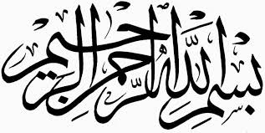
Dissension in Islam
Rafi Ahmed, Ph.D.
October 29, 2018

Slide 2
Outline
Background
Selection of the four Khalifas
Civil wars and the origin of monarchy
Development of Shiism
Reasons for the dissension
Synopsis
2

Slide 3
Background
3

Slide 4
Primary Sources
Modern Sources
  The Origin of Dissension in Islam, Hadrat Mirza Mehmud Ahmad^{RZ}, 1919
  Khilafat-e-Rashida, Hadrat Mirza Mehmud Ahmad^{RZ}, 1939
  A History of the Arabs, Phillip K. Hitti, 1961
  A History of the Arab Peoples, Albert Hourani, 1992
  After the Prophet, Lesley Hazleton, 2009
  Encyclopedia Britannica, 2008
Classical sources
  Life of the Prophet (Seerat Rasul-Allah), Ibn Ishaq
    Sunni scholar (704-767) during Abbasid, Caliph Mansur; the original text of the biography did not survive; was edited by Ibn Hisham
  A History of the Prophets and Kings, Abu Jafar Al Tabari
    Sunni scholar (838-923) during Abbasid Caliph, Al Muqtadir
  Book of History and Campaigns, Abdullah Al Waqidi
    Sunni scholar (748-822) during Abbasid Caliph, Harun Al Rashid
Notes:
Tabari is the most widely used classical source. It was written
more that two hundred years after the dissension. It contains
multiple variant reports of the same incident by different reporters
without giving any information about the relative reliability of
the reports.

Slide 5
Terminology
The Rightly-guided (Rashedun): the term used to distinguish the first four righteous khalifas – Hadrats Abu Bakr, Umar, Uthman, and Ali – from the subsequent kings/autocrats. The term was coined by the theologian Ibn Taymiyyah in the 14th century
Quraysh: the dominant tribe of Mecca at the advent of Islam; the Prophet and the four khalifas belonged to this tribe
Umayyad: a major clan of the Quraysh
The Emigrants (Muhajirun): the Meccan Muslims who emigrated to Medina during the time of the Prophet
The Supporters (Ansar): the Medinese Muslims who helped the Emigrants during the time of the Prophet
The Companions (Ashab): Muslims who were the Prophet’s companions; they include the Supporters and the Emigrants.
Notes:
Hadrat Uthman, Muawiyah, and many prominent people in the early Islamic
history belonged to the clan of Umayyad.
The designation of “the rightly-guided’ passes a historical and theological verdict
on the distinction between the first four khalifas and the kings who followed them.
There is no need for an artificial designation between the terms khilafat and and
caliphate.

Slide 6
Chronology of Events
622 CE: Emigration of the Prophet (hijrah)
632-634 CE: Khilafat of Hadrat Abu Bakr
632-634 CE: the Battles of Apostasy-Secession (Ridda)
634-644 CE: Khilafat of Hadrat Umar
644-656 CE: Khilafat of Hadrat Uthman
656-661 CE: Khilafat of Hadrat Ali
656 CE: the First civil war; the Battle of the Camel
657 CE: the First civil war; the Battle of Siffin
661-680 CE: Reign of Muawiyah
680 CE: the Second civil war
800-1000 CE: The Sunni-Shia split
Notes:
After the Prophet’s demise in 632, Hadrat Abu Bakr was elected
Khalifa, and his khilafat lasted two years from 632 to 634.

Slide 7
Relational Interconnections
Hadrat Ali was a first cousin and a son-in-law of the Prophet^{SAW}
Hadrat Abu Bakr was the father of Hadrat Ayesha, a wife of the Prophet^{SAW}
Hadrat Umar was a father-in-law of the Prophet^{SAW} and a grand son-in-law of the Prophet^{SAW}, as he married Umm Kulthum, a daughter of Hadrats Ali and Fatima
Hadrat Uthman was a son-in-law of the Prophet^{SAW}
Hadrats Hasan and Hussain were sons of Hadrat Fatima and Ali and grandsons of the Prophet^{SAW}
Hadrat Ali married Asma, the widow of Hadrat Abu Bakr, and adopted their three year-old son, Mohamed Ibn Abu Bakr, a half-brother-in-law of the Prophet^{SAW}
Muawiyah was a son of Abu Sufian and Hind and a brother of Hadrat Umme Habiba, a wife of the Prophet^{SAW}
Notes:
All the main personalities in the early Islamic history were related to the
Prophet and often to each other.

Slide 8
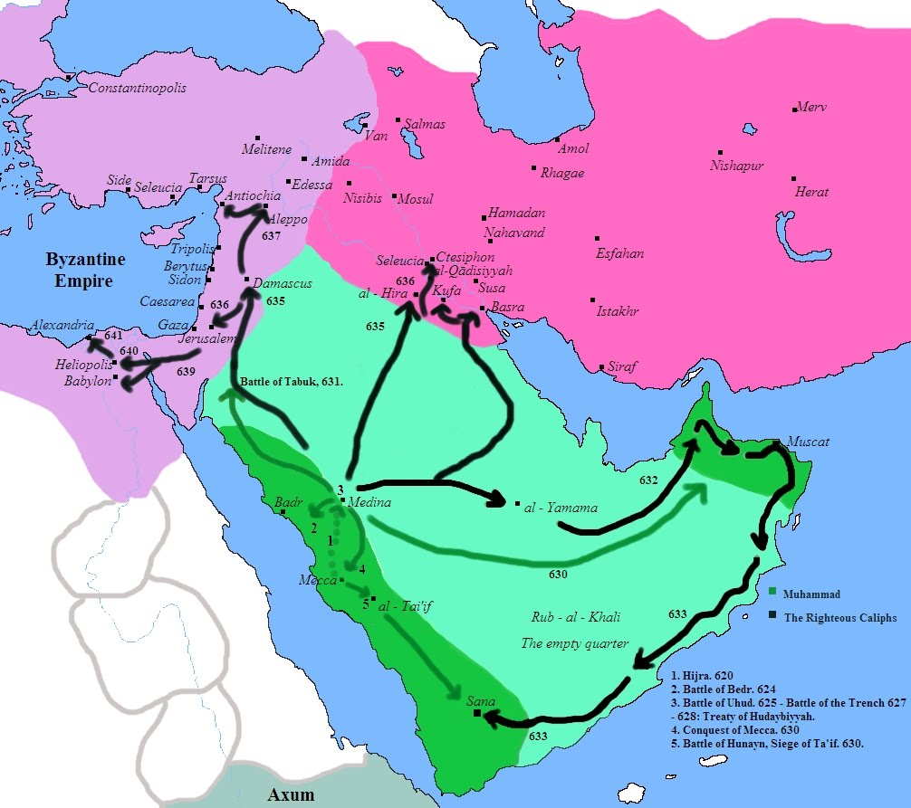
Muslim Expeditions [620-641 C.E.]
Prophet's emigration (hijrah) is shown by the red arrow.
Prophet's excursions are shown by the green arrows.
Notes:
Light pink is the Byzantine Empire. Dark pink is the Sassanid Empire.
Three types of arrows: red, green, and black
Point out the Arabian peninsula comprises light and dark
green. Hijaz is dark green area on the Western side.
At this point, the Prophet has passed away; and we are about
to embark upon a new phase in the history of Islam.

Slide 9
The Rightly-Guided Khalifas
9
Notes:
The first four khalifas are called rightly-guided (rashedun), because
of their piety and the legitimacy of the process by which they were
elevated to the office of khilafat.

Slide 10
Selection of Hadrat Abu Bakr [632 C.E.]
Three factions at the time of the selection of Prophet’s successor (khalifa): 1. the Prophet’s family; 2. the Emigrants; and 3. the Supporters.
After some dispute, people settled on the Emigrants from which the khalifa was to be chosen.
Hadrat Abu Bakr suggested the names of Hadrat Umar and Abu Ubaida, but they declined.
Hadrat Abu Bakr was then elected khalifa by the consensus of most Muslims present in Medina.
Hadrat Ali took pledge of allegiance after a few days/months.
Notes:
The Arabian tradition of selecting a chief was not hereditary.
Every faction wanted khalifa to be chosen from among themselves.
Some reports mention days, some months. There are reports
that Hadrat Umar put pressure on Hadrat Ali to pledge allegiance
to Hadrat Abu Bakr, the new Khalifa.

Slide 11
Battles of Apostasy-Secession (Ridda) [632-634 C.E.]
After the Prophet’s death, all non-Hejazi Arabian tribes seceded and broke away from the khilafat-state.
The tribes claimed that only the Prophet was authorized to receive zakat; they refused to pay zakat and attacked Muslims:
  Theirs was more of a political alliance than religious conversion.
  Acceptance of Islam by a tribal chief often meant a nominal acceptance by the entire tribe.
  They had no tradition of obeying a central, supra-tribal authority
Hadrat Abu Bakr insisted on their unconditional surrender.
The rebellion was suppressed and the tribes that surrendered were pardoned.
Their remains a controversy whether this was apostasy or secession. Some tribes remained Muslim and rebelled from the state, but others renounced Islam and became apostates.
Notes:
In any case the understanding of Islam and khilafat was extremely rudimentary.
“Arabia had to conquer itself before it could conquer the world.”

Slide 12
Selection of Hadrat Umar [634 C.E.]
During his last days, Hadrat Abu Bakr sought advice from the Companions regarding the choice of his successor.
Most of the Companions indicated that Hadrat Umar should be the khalifa.
Hadrat Abu Bakr agreed with them and announced the nomination of Hadrat Umar as the next khalifa.
The people at Medina generally agreed with the nomination and there was little controversy.
Notes:
It was a nomination with popular support. And everything went smoothly, Hadrat Ali
was one of the first to pledge allegiance. After a short while, he gave his daughter in
marriage to Hadrat Umar, who thus became a grand son-in-law of the Prophet.

Slide 13
Selection of Hadrat Uthman [644 C.E.]
When Hadrat Umar was fatally injured, he appointed a six-man electoral college to elect a khalifa from among themselves.
The electoral college included Hadrats Uthman, Ali, Abdur Rehman bin Auf, Saad bin Waqqas, Zubair, and Talha.
Hadrat Umar ordered that “any one who declines to take the pledge of allegiance of the next khalifa shall be executed.” [Khilafat-e-Rashida by Hadrat Khalifatul-Masih^{RZ} II]
After a prolonged debate, Abdur Rehman and two others withdrew their candidacies; Hadrat Ali did not.
The electoral college authorized Abdur Rehman to nominate the khalifa.
Abdur Rehman, after consultation with Medinese Muslim men and women, nominated Hadrat Uthman as the next khalifa.
Notes:
He was stabbed by a Christian, Persian, slave, who had a personal grievance against him.
The quote from Hadrat Umar comes from the book “Khilafat-e-Rashida”.
I think this selection of khalifa can still be called nomination, Since the electoral college
was required to elect a khalifa from among themselves.
There are no reports of any controversy, since Hadrat Uthman like his two predecessors
was known to be an extremely pious and generous man.

Slide 14
Assassination of Hadrat Uthman [656 C.E.]
Allegations of mismanagement and nepotism were made against Hadrat Uthman: all the provincial governors he appointed were his Umayyad kinsmen.
A conspiracy was hatched by a few Medinese Muslims and many neo-Muslims under the leadership of Abdullah bin Sabah
A large armed contingents of neo-Muslims came from Kufah, Basra, and Egypt and demanded that Hadrat Uthman should resign.
Hadrat Uthman was killed in his house by a handful of armed men.
One of the main instigators was Muhammad bin Abu Bakr, the adopted son of Hadrat Ali.
Hadrat Uthman’s assassination in Medina, his capital, in his own house at the height of Muslim imperial glory remains polemical and incomprehensible.
Notes:
At this point, we must remind ourselves that Hadrat Uthman was a very pious man. He might
have made some errors of judgment, but no one can doubt his integrity.
But still why did the dissension started at the time of khilafat? This we will discuss shortly.
Abdullah bin Sabah was a Jewish convert to Islam.

Slide 15
Selection of Hadrat Ali [656 C.E.]
After Hadrat Uthman was martyred, the Medinese Companions endorsed Hadrat Ali for khilafat.
Many of the conspirators and miscreants came forward as strong supporters of Hadrat Ali and championed his cause.
Hadrat Ali was persuaded to accept khilafat, since he was recognized as such in most of the Empire.
Soon thereafter, he left Medina and moved his capital to Kufah.
Hadrat Talha and Zubair were probably forced to take the pledge but on the condition that murderers of Hadrat Uthman will be arrested and punished. Later they withdrew their pledges.
Hadrat Ayesha, Muawiyah (the governor of Syria), and others did not recognize Hadrat Ali as the khalifa.
It would be fair to say that Hadrat Ali was elected by acclamation.
Notes:
Hadrat Talha and Zubair were Companions of the Prophet and brothers-in-law of
Hadrat Ayesha.
Muawiyah was an Umayyad and a kinsman of Hadrat Uthman.

Slide 16
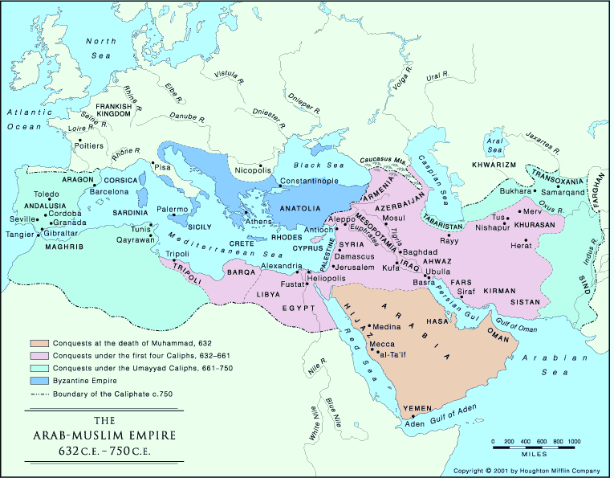
The Muslim Empire [632-750 C.E.]
Notes:
Beige is the Islamic region at the end of the Prophet’s and Hadrat Abu Bakr’s lives.
Pink is the conquest made by the rightly-guided khalifas, that is, the first four, khalifas.
The green region was added to the Muslim Empire during the time of Umayyad dynasty.
The four shifting centers of power. From Medina, to Kufah during the time of Ali, and then
Damascus, which became the capital of Muawiyah and the Umayyad dynasty; and then
Baghdad, the capital of the Abbasid dynasty.

Slide 17
Civil Wars and the Origin of Monarchy
17

Slide 18
The First Civil War [656-657 C.E.]
Hadrat Ali did not apprehend the assassins of Hadrat Uthman as demanded by his opponents; he might have pardoned some of them for the sake of peace.
Hadrat Ali fought several wars over this issue.
The Battle of the Camel (656 C.E.)
  Hadrats Ayesha, Talha, and Zubair fought against Hadrat Ali.
  Hadrat Ali won this battle; Talha and Zubair were killed in the battle; Hadrat Ayesha was granted clemency; she retained her prestige and pension.
The Battle of Siffin (657 C.E.)
  Hadrat Ali deposed all the governors appointed by his predecessor; but Muawiyah, the governor of Syria, refused to step down.
  In the war between Muawiyah and Hadrat Ali, Ali had an upper hand; Muawiyah demanded arbitration using a ruse; the result of arbitration was deceptive and ambiguous resulted in both keeping their respective positions.
Muawiyah constantly marginalized and threatened Hadrat Ali’s regime; he captured Egypt and killed Hadrat Ali’s adopted son, Mohamed bin Abu Bakr, who was the governor of Egypt.
Notes:
It remains unclear whether Hadrat Ali was unwilling or unable.
There are reports that he granted pardon to the assassins of
Hadrat Uthman. Muhammad bin Abu Bakr, one of the main
instigators, was pardoned and appointed governor of Egypt by
Hadrat Ali.
It is called the Battle of the Camel because Hadrat Ayesha rode
a red camel directing her troops.
There are contradictory views about the nature of arbitration.
Most historians write that the arbitration was to decide the
legitimacy of his khilafat. Hadrat Mirza Mehmud Ahmad wrote
in his book “Khilafate-Rashida” that arbitration was to resolve the
issue of the murderers of Hadrat Uthman.

Slide 19
Assassination of Hadrat Ali [661 C.E.]
Many extremists supporters of Hadrat Ali turned against him for agreeing to the arbitration and claimed that it violated the judgment of the Quran.
These former supporters of Hadrat Ali. known as the Seceders (Kharijite), rejected his khilafat, elected their own leader, and withdrew to another region.
These Seceder were suppressed by Hadrat Ali through many military campaigns.
Hadrat Ali was assassinated by a Seceder in a Kufah mosque.
After his death, Muawiyah declared himself the “khalifa” of the Muslim empire and founded the Umayyad dynasty. He was the first king in Islamic history.
Hadrat Hasan was proclaimed the khalifa by his small band of supporters; but he accepted a generous pension and relinquished his claims in favor of Muawiyah.
Notes:
Generally, it is believed that Muawiyah was not involved in the
assassinations of Hadrat Ali.
Hadrat Hasan, who was the eldest son of Hadrat Ali, relinquished his
claims in lieu of a generous remuneration. He was later poisoned in
a harem intrigue.

Slide 20
The Second Civil War [680 C.E.]
Muawiyah had designated his son, Yazid, as his successor.
At his father’s death in 680, Yazid became the king of the Muslim empire, although was called “khalifa”.
The Muslims of Kufah, who called themselves Shia-e-Ali (the Partisans of Ali) acclaimed Husain, the second son of Hadrat Ali, as khalifa.
Hadrat Hussain set out from Medina to Kufah with a small army of 70 men belonging to the Prophet’s family.
Hadrat Hussain’s army was attacked and decimated by Yazid’s troops in a field near Kufah (Karbala) .
The brutal assassination of Hadrat Hussain and his family members later became an iconic event in Shi'a historical development.
Notes:
This was the beginning of a dynastic monarchy in the history of Islam.
Hadrat Hussain was the second son of Hadrat Ali.
It should be noted by this time there was no Shiism, as we know it now. Shiism
gradually developed in later centuries.

Slide 21
Development of Shi’ism
21

Slide 22
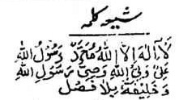
Shi’ism
Belief in the primacy of Hadrat Ali and the divine right of the family of the Prophet (aale-Muhammed) to lead the Muslims is central the Shi’a faith.
Preservation and transmission of revealed truth by the lines of imams; Hadrat Ali is believed to be the first imam
In Shi’ism, the theory of the imamat gradually developed from the 10th century onward.
The martyrdom of Hadrat Hussain is observed by the Shi'as as an iconic event in Islamic history and as an essential element of their faith.
Rejection and revilement of the first three Khalifas and their supporters
Shi’ism expanded under the Buwahid dynasty (934-1055), which controlled modern-day Iran and Iraq.
Shia Kalama: “There is no one worthy of worship but Allah. Muhammad is the Messenger of Allah. Ali is the guardian (imam) appointed by Allah and the executor of the will of the messenger of Allah and his first khalifa.”
Notes:
It is contended that Shiism is not about struggle for political power.
No Shia, as we know it today, was present during the time of Hadrat Al and Hussain
Imamat in place of khilafat.

Slide 23
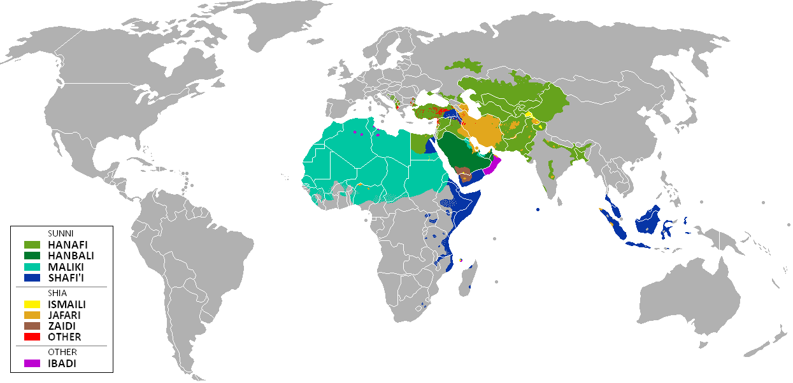
Modern-Day Sunni-Shia Distribution

Slide 24
Synopsis
24

Slide 25
A Prophecy
Prophethood shall remain among you as long as God wills. Then khilafat on the pattern of prophethood will commence and remain as long as He wills. A corrupt monarchy shall then follow and it shall remain as long as He wills. There shall then be a tyrannical despotism which shall remain as long as God wills. Then once again khilafat will emerge on the precept of prophethood.
[Prophet Muhammad^{SAW}, Masnad-­Ahmad]
Notes:
The history bears witness to the events prophesized.

Slide 26
State of the Muslim Empire [650-661 C.E.]
At this point in history, the Muslim Empire was large and prosperous.
By this time, the Muslims had conquered all of the Sassanid (Persian) and part of the Byzantine empires, the two great superpowers of the past.
The Empire was expanding and becoming one of the greatest empires the world has ever seen.
Revenue from the conquered lands was plentiful and the booty from wars was bountiful.
The companions received special pensions from the treasury of the state.
Arabs from Mecca and Medina were the ruling elites of the Musim Empire.

Slide 27
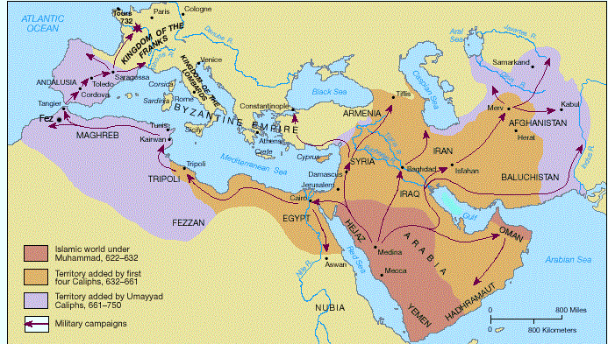
Expansion of Islam

Slide 28
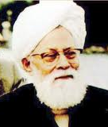
Factors Underlying the Dissension
[The Origin of Dissension in Islam, by Hadrat Khalifatul-Masih II, 1919]
Lack of religious conviction in some neo-Muslims (i.e., newly-converted Muslims), who had accepted Islam as a political compromise
Resentment of the Companions’ power, privilege, and prestige by some neo-Muslims of weak faith
Scheming against khilafat and Muslim unity by a group of new converts, who were pseudo-Muslims
Extreme dissatisfaction felt by some neo-Muslims with non-democratic strains in the khilafat
Notes:
Hadhrat Mirza Mehmud Ahmad^{RZ} in his book “The Origin of Dissension
in Islam” (Islam me Ikhtilafat ka Aghaz) has mentioned these four factors.
The non-democratic strains in the khilafat are unavoidable in a spiritual system.
The neo-Muslim, as they accepted Islam in large groups often as part
of a political compromise, lacked the spiritual and moral training
needed to inculcate the fundamental Islamic values.

Slide 29
Summary
Evolving nature and scope of the institution of khilafat
Lack of protocol for the election of and eligibility for khalifa
Lack of guidelines about voting rights
Meteoric rise of the Arabs as the elites of a powerful empire
Internal rivalry for acquiring power, where too much was at stake
Conversion that followed conquest created quandary and confusion
Ambivalent status of neo-Muslims in the expanding Muslim empire
Notes:
[first time in Islamic history, Hadrat Khalifatul-Masih II, instituted a
well-defined protocol for the election of khalifa]

Slide 30
Q
A
&
Q U E S T I O N S
A N S W E R S
30

