Slide 1
Authenticity of Hadith
In the name of Allāh,
the Gracious, the Compassionate.
We praise Him and invoke His Blessings
on His Noble Prophet.

Slide 2
Authenticity of Hadith

Slide 3
Once a poor Muslim paid his respects to the Holy Prophet (peace be on him and blessings of Allāh). In his extreme desire for a close personal and permanent association with the Prophet, he asked of him, a little haltingly,
“O Prophet of Allāh! When will be the Day of Resurrection?”
The Holy Prophet replied, “You ask of the Day of Resurrection; have you made any preparations for it?”
With trembling lips and palpitating heart, he submitted, “My Lord, I have not made any special preparations in respect of Prayer and fasting but I have in my heart true love of Allāh and of his Prophet.”
With an affectionate glance at him, the Prophet told him not to worry over much and rest assured that the Loving God would not keep anyone apart from the object of his love.
Forty Gems of Beauty—4

Slide 4
Authenticity of Hadith
What is a Hadith?
Importance of Hadith
What is the position of Hadith in Islamic guidance?
What is the basic terminology?
How is the authenticity of Hadith established?
Forty Gems of Beauty

Slide 5
What is a Hadith?
“Hadith are those Traditions which were compiled from the statements of diverse narrators a century and a half after the Holy Prophet (saw)”
[Review on the debate between Batalwi and Chakralvi, Ruhani Khaza’in, Vol.19, pp.209-212]

Slide 6
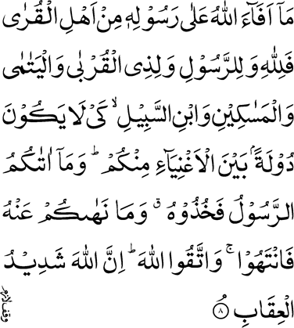
Importance of Hadith
[59:8] …. And whatsoever the Messenger gives you, take it; and whatsoever he forbids you, abstain from that. And fear Allah; surely, Allah is Severe in retribution.

Slide 7
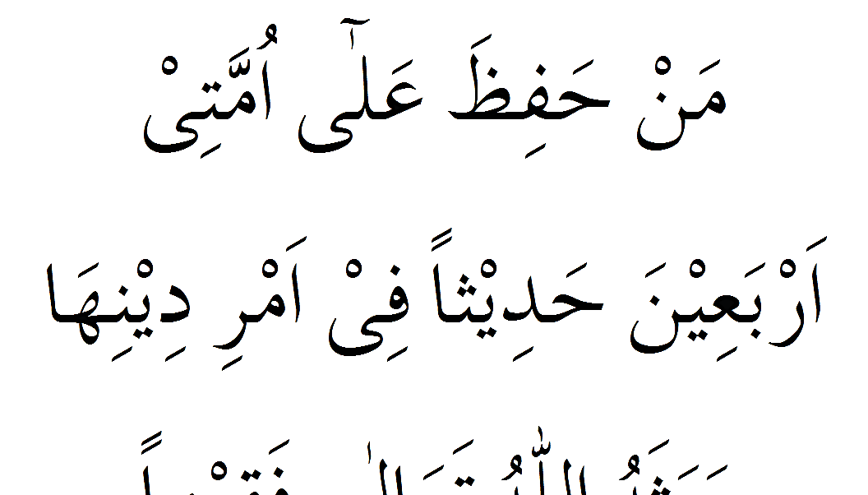
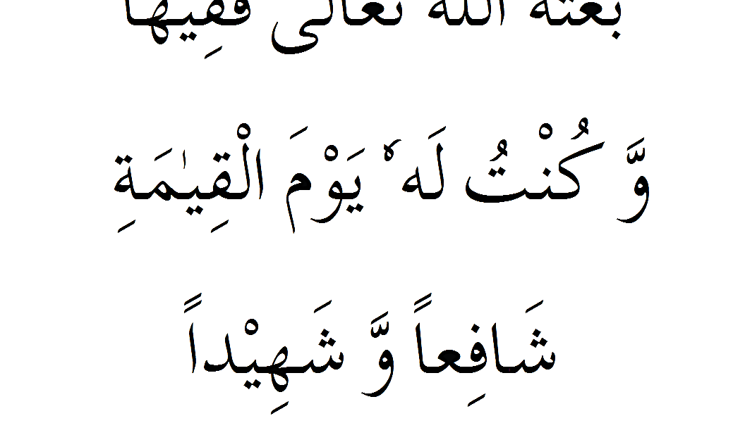
Importance of Hadith
The Holy Prophet Muḥammad, peace and blessings of Allāh be on him, said:
Whoso, with a view to the welfare and
reformation of my people, committed to memory at least forty of my Aḥādīth, Allāh, the Excellent, will raise him up on the Day of Resurrection as a jurist and religious Divine, and I will be his intercessor with Allāh and a witness to his faith. (Baihaqī)

Slide 8
Importance of Hadith
To meet our needs of knowledge and tarbiyyat
To raise awareness about common Fiqahee issues
To take the message of Islam to others
Adapted from Hadiqatus Saliheen Foreword to 3rd Edition

Slide 9
What is the position of Hadith in Islamic guidance?

Slide 10
Sources of Islamic Guidance
I hold very firmly that for your guidance, God has provided three things
The Holy Qur’an
Sunnah
Hadith
Our Teaching Page 17
Notes:
Add Reference

Slide 11
Sources of Islamic Guidance
The Holy Qur’an
The Book of God than which we have no more conclusive and certain statement. It is the Word of God and is free from all doubt and speculation.
Sunnah
The practice of the Holy Prophet (peace and blessings of Allah be on him)
Hadith
The traditions which were compiled from the statements of diverse narrators a century and a half after the Holy Prophet (peace and blessings of Allah be on him)
[Review bar Mubahatha Batalwi wa Chakralwi, Ruhani Khaza’in, vol. 19, pp. 209-212]
Essence of Islam Vol II Page 129-132

Slide 12
The Promised Messiah ( on whom be peace) said
The Qur’an and Sunnah should judge the Ahadith and those that are not opposed to them should by all means be accepted.
This is the straight path and blessed are those who follow it.
Most unfortunate and foolish is the person who rejects the Ahadith altogether without regard to the test that we have proposed.
[Review bar Mubahatha Batalwi wa Chakralwi, Ruhani Khaza’in, vol. 19, pp. 209-212]
Essence of Islam Vol II Page 132

Slide 13
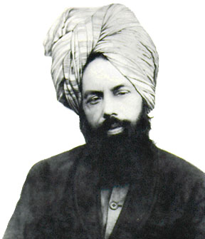
The Promised Messiah ( on whom be peace) said
It should be the duty of the members of our Community that a Hadith which is not opposed to the Qur’an and Sunnah, should be accepted and followed, however weak might be its authority, and it should be preferred to the rules framed by jurists.
[Review bar Mubahatha Batalwi wa Chakralwi, Ruhani Khaza’in, vol. 19, pp. 209-212]
Essence of Islam Vol II Page 132

Slide 14
What is the basic terminology?

Slide 15
Terminology
The companions of the Holy Prophet ^{sa}
Muhaddithin
Sahabi
Tābi‘īn
Taba Taba‘ Tābi‘īn
Taba‘ Tābi‘īn
Those who saw and met the Taba Tābi‘īn
Scholars of Hadith
Those who saw and met Companions of the Holy Prophet ^{sa}
Those who saw and met the Tābi‘īn
200
Years
80
60
40
120
100
180
160
140
20
AFTER
Adapted from Hadiqatus Saliheen Page 18
Adapted from Life and Character of the Seal of the Prophets, Vol 1, p. 13-15

Slide 16
Terminology
Chain of narration
Ravi
Narrator
Athar
Hadith
Sanad
A narration that reaches the Holy Prophet saw
A narration that ceases at one of the companions
Adapted from Hadiqatus Saliheen Page 7

Slide 17
Narrators of Ahadith
Hadhrat Annas Bin Malki ra 22,00
Hadhrat Abdullah Bin Omar ra 26,00
Hadhrat Ayesha ra 2200
Hadhrat Jabir Bin Abdullah ra 16,00
Hadhrat Abdullah Bin Masood ra 848
Hadhrat Abdullah Bin Umroo ra 700
Hadhrat Ali ra 586
Hadhrat Umar ra 537
Hadhrat Abu Zarr ra 281
Hadhrat Abu Bakr ra 132
Hadhrat Abu Huraira ra 5300
Adapted from Hadiqatus Saliheen Page 15

Slide 18
How is the authenticity of Hadith established?

Slide 19
Terminology
Dirayat
Riwayat
The objective is to put to trial the internal testimonies of the instance that has been narrated.
The objective is to test the external testimonies of the instance which has been narrated.
That is, whether the instance in itself and on the basis of its environment, can be presumed to be true and authentic.
Hence the purpose is to determine whether the channel through which the narration has reached us is adequately reliable or not.
Narration
Narrator
Life and Character of the Seal of the Prophets, Vol 1, p. 13-15

Slide 20
Authenticity of Ahadith
The Ahadith are divided into two parts. One part is that which is completely protected by practice, that is to say such Ahadith as
are strengthened and are carrying the degree of certainty by the firm and strong and certain method of practice,
and which are comprehensive of all religious needs and worship
and covenants and dealings and the commandments of the law.
[Al-Haq, Mubahatha Ludhiana, Ruhani Khaza’in, vol. 4, p. 35]
Essence of Islam Vol II Page 134-135

Slide 21
How is the authenticity of Hadith established?
Dirayat
Narration to be true and authentic
1. The narration should not be contradictory to any reliable and authentic historical record. In accordance with this principle any narration which contradicts the Holy Qur’ān, must be disregarded
2. The narration should not clash with any evidently proven fact
3. The narration should not be contradictory to any narration of greater authenticity
4. The narration should not be of an incident which, if true, should have a greater number of people to testify to it, yet only one narrator is existent
5. The narration should not have such elements as can be negated or considered ambiguous by common sense
Life and Character of the Seal of the Prophets, Vol 1, p. 13-15

Slide 22
How is the authenticity of Hadith established?
Riwayat; Narrator adequately reliable or not.
3. The narrator should possess the ability to comprehend and rationalize.
4. The narrator should possess a sound memory.
5. The narrator should not be one to habitually exaggerate, summarize or sway original reports in any way.
6. The narrator should not have a personal interest in the narration that is related, lest one may categorize the narrator as biased.
7. The encounter of two narrators who come after one another must be acceptable, based on their time periods and circumstances.
8. All the links of the narration should be fully preserved and no narrator should be missing from the top, middle or bottom.
9. As per the above mentioned characteristics, the solidity of any narration increases with an increase in the credibility and trustworthiness of its narrators.
10. In the same manner, the strength and authenticity of a narration multiplies as the number of credible narrators increases
1. The narrator should be well-known.
2. The narrator should be truthful in speech and honest.
Life and Character of the Seal of the Prophets, Vol 1, p. 13-15

Slide 23
Types of Ahadith; according to chain of narrators
Muhaddithin
Sahabi
Murffoo
Tābi‘īn
Taba Taba‘ Tābi‘īn
Taba‘ Tābi‘īn
Direct quotation
Continuous chain of narrators
Muhaddithin
Sahabi
Muttasil
Tābi‘īn
Taba Taba‘ Tābi‘īn
Taba‘ Tābi‘īn
Adapted from Hadiqatus Saliheen Page 8

Slide 24
Types of Ahadith; according to chain of narrators
Muhaddithin
Sahabi
Mursal
Tābi‘īn
Taba Taba‘ Tābi‘īn
Taba‘ Tābi‘īn
No Companions in the chain of narrators
No companion and broken chain of narrators
Muhaddithin
Sahabi
Munqata
Tābi‘īn
Taba Taba‘ Tābi‘īn
Taba‘ Tābi‘īn
Adapted from Hadiqatus Saliheen Page 8

Slide 25
Types of Ahadith; according to number of narrators
Mutwatar
Mashhoor
Azeez
Ghareeb
A number of people
At least 3 narrators at each step
At least 2 narrators at one step
One narrator at one step
Adapted from Hadiqatus Saliheen Page 8-9

Slide 26
Types of Ahadith; according to the qualities of narrators
Sahih ( sound and authenticated)
Hassan ( good)
Dhaeef (weak)
Mauzoo (fabricated)
Many pious, truthful narrators with good memory
Many pious, ruthful narrators, memory!
Questions about piety or memory of narrator
Untruthful narration
Maqbool
( accepted)
Murdood (rejected)
Adapted from Hadiqatus Saliheen Page 8-9

Slide 27
Collection of Ahadith books
Mu’ajjam
Jam’i
Sunnan
Saiheen
Sihae Sitta
Musnad
Collection by Sahabi narrators
Collection by narrators
Collection by topics
Collection by rules and regulations (chapters of Fiqah)
Collection by authenticity Sahi Bokhai and Muslim
Six authentic books
Adapted from Hadiqatus Saliheen Page 10

Slide 28
Collection of Ahadith books
Sahih Bukhari
Sahih Muslim
Jam’i Tirmidhi
Sunan Abu Dawud
Sunan Nasa’i
Sunan Ibn Majah

Slide 29
The Promised Messiah ( on whom be peace) said
Of the other books that are accepted by us the Sahih of Bukhari ranks as the first. All its Ahadith which are not opposed to the Holy Qur’an are in our view authoritative.
Next comes Sahih Muslim. We accept its authority subject to the condition that it should not be opposed to the Holy Qur’an and Sahih Bukhari.
Next to them are the compilations of Tirmidhi, Ibn-e-Majah, Muattah of Imam Malik, Nassa’i, Abu Da’ud and Dar Qutni, which we regard as authoritative so long as they are not opposed to the Holy Qur’an and Bukhari and Muslim.
These are our religious books and these are the conditions under which we accept them.
Arya Dharam, Ruhani Khaza’in, vol. 10, pp. 86-87
Essence of Islam Vol II Page 135

Slide 30
Summary
“Hadith are those Traditions which were compiled from the statements of diverse narrators a century and a half after the Holy Prophet (saw)”
“I hold very firmly that for your guidance, God has provided three things; the Holy Qur’an, Sunnah, Hadith”
“A Hadith which is not opposed to the Qur’an and Sunnah, should be accepted and followed”
Terminology and science of authenticity of Hadith explained

Slide 31
God knows well that, in writing this booklet, I have been prompted solely by the love I bear to the Holy Prophet
so that if God so wills a spark of his love may ignite the hearts of its readers—the spark that is the soul of every virtuous act and life of every moral excellence
and that they may listen to the observations of their most loved Master with sincere devoutness and heart-felt devotion and make them their life-amulets
O Lord of Mercy, Most Compassionate of all the Merciful.
and that, it may also be, for me, a means of Allāh’s forgiveness and protection and of the Prophet’s intercession Amen!
Forty Gems of Beauty—5

