Slide 1

Existence of God
A Quranic Perspective
Rafi Ahmed
June 6, 2018

Slide 2
Outline
Terminology
Quranic claims
Method of discourse
Logical evidence
Scientific evidence
Quranic evidence
Reasons for atheism
Pascal’s wager
2

Slide 3

Terminology
Atheists believe that God does not exist.
Agnostics believe that we cannot know whether God exists or not.
Deists believe in a non-personal God and reject religion.
Theists believe in God and religion.
Heavens refers to the expanse of space surrounding the earth.
3
Notes:
Agnostics essentially do not care about the question of the
existence of God.

Slide 4
Quranic Claims
4

Slide 5
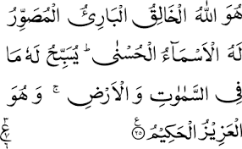
The Originator
He is Allah, the Creator, the Originator, the Designer. His are the most beautiful names. All that is in the heavens and the earth glorifies Him; and He is the Mighty, the Wise. [59:25]
5

Slide 6
Creation Out of Nothing
He is the Originator of the heavens and the earth. When He decrees a thing, He says to it ‘Be’, and it is. [2:118]
And man says, ‘Will I really be resurrected when I am dead?’. Does not man remember that We created him before when he was nothing? [19:67-68]
Were they created from nothing, or are they themselves the creators? [52:35]
Notes:
Creation ex nihilo
“No stories of the giant and the cow” A chapter named in
Weinberg’s book
No mention of sun revolving around the earth

Slide 7
The Origin of the Universe
Do the unbelievers not see that the heavens and the earth were a closed-up mass, then we clove them asunder? And We made every living thing from water. Will then they not believe? [21:31]
And the heavens We built with our own powers and indeed We go on expanding it. [51:48]

Slide 8
Method of Discourse
8

Slide 9
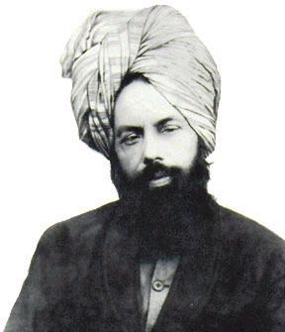
  Religion and Science
  “That is why God has sent me so that we demonstrate it to the world that there is nothing in (our) religion that contradicts true and proven facts of science.”
  Hazrat Mirza Ghulam Ahmad^{AS}
  ‘Zikr-e-Habeeb’ by Hazrat Mufti Muhammad Sadiq
Notes:
In response to a question from the British astronomer,
Prof. Clement Regg.
And finally, here is his view about science versus religion.
A statement of wide implication – note his emphasis on true
and proven facts of science, not merely conjectural or
inferential.
“Isi liay to Khuda in hamen bheja hai ta hum duniya
per zahir karen ke mazhab ki koi baat sachchi or
sabit shuda haqiqate science ke khilaf nahin.”
This is a timeless message of abiding value.

Slide 10
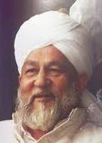
Rationality Vs. Blind Faith
“The Quran is a book of reason and rationality … Thus to interpret the verse 2:3-4 to indicate that it promotes blind faith by requiring man to believe in the ‘unseen’ (ghaib) would stand counter to the Quranic emphasis. Quite to the contrary, to believe in the spurious without evidence and solid justification is what the Quran attributes to the non-believers.”
[Hazrat Mirza Tahir Ahmad^{RZ}, ‘Revelation, Rationality, Knowledge and Truth’]
Notes:
Chapter 2, Verses 3 and 4 “… it is a guidance for the righteous,
Who believe in the unseen.

Slide 11
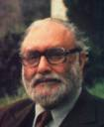
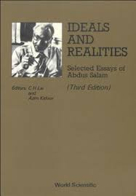
Reason and Religion
“In contrast to 250 verses which are legislative, some 750 verses of the Holy Quran exhort the believers to study Nature, to reflect, to make the best use of reason and to make scientific enterprise an integral part of the community’s life. The Holy Prophet of Islam (peace be on him) said that it was incumbent upon every Muslim – man and woman – to acquire knowledge.”
[Dr. Abdus Salam, Nobel Laureate, ‘Ideals and Realities’]
Notes:
Huzoor uses this quote from Dr. Salam’s book ‘Ideals and Reality’.

Slide 12
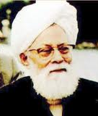
  The Ultimate Question
  “If people believe in God on hearsay or declare a belief in God in order to avoid debate, then this will not guarantee their salvation. Therefore, it is of utmost importance that considerable thought be given to the question of the existence of God.”
  [Hazrat Mirza Mahmud Ahmad^{RZ}, ‘Hasti Bari Tala’]
Notes:
A quote from Huzur’s book on the existence of God.

Slide 13
  The Method of Discourse
  We should embrace science and the scientific method.
  We should adopt rational and evidence-based approach.
  The burden of proof on the claimant – that is, those who believe in God must furnish reasons for their belief.
  The proof for or against the existence of God is of a different type than mathematical or Euclidian proofs.
  One can conceive of rational evidence for the existence of a supreme creator.
Notes:
We cannot ask others to prove that God does not exist.

Slide 14
Logical Evidence
14

Slide 15
The Kalam Cosmological Argument
The Kalam cosmological argument was developed by medieval Muslim logicians and popularized in the West by philosopher William Craig
Given that an observable universe exists, there are three possibilities:
  The universe always existed.
  The universe created itself.
  An all-powerful, all-knowing, transcendent being created it.
Notes:
Omnipotent, omniscient
The Kalam cosmological argument for the existence of God

Slide 16
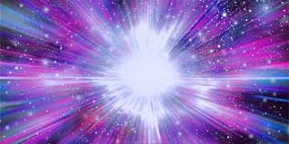
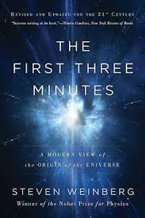
1. Did the Universe Always Exist?
According to the 2nd Law of Thermodynamics, if the universe had existed for ever, it would have collapsed and suffered a heat death long, long ago.
According to the Big Bang theory, about 13.8 billion years ago, the universe originated in a “big bang” explosion from a highly compressed state and expanded rapidly. And it continues to expand today.
The point of origin of the universe is called a singularity, where the laws of physics break down.
No, the universe did not always exist.
Notes:
The Big Bang theory is a widely accepted theory. It is considered a part
of the Standard Model.
The universe could be considered a self-explanatory fact.
The Second Law of Thermodynamics and and the theory of entropy.
Before the Big Bang, there was a singularity or many singularities.
Based on the general theory of relativity and the
Cosmological (isotropic and uniform) principal.

Slide 17
2. Did the Universe Create Itself?
Nothing in our observations creates itself.
Everything that begins to exist has a cause.
The cause must precede the effect.
The universe began to exist.
The universe then must have a cause – the Prime Cause – if an infinite regression is to be avoided.
No, the universe did not create itself.
Notes:
Just look at the Schrodinger’s equation

Slide 18
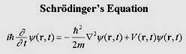
3. Did God Create the Universe?
God is postulated as an omnipotent, omniscient, transcendent being.
The existence of space, time, matter and energy in the universe requires underlying laws of physics governing them.
The fundamental laws of physics, in turn, demand abstract mathematical formulations that describe them.
The mathematical abstraction alone indicate an indescribably powerful intelligence behind it.
Yes, God created the Universe.

Slide 19
Creation of the Creator?
If the universe needed a creator, but then who created God?
  Richard Dawkins, a well-known atheist, in his book, ‘The God Delusion’, presents this question as the most powerful argument against theism.
Here we have two alternatives:
  The universe – which has neither mind nor consciousness nor will nor intelligence – first devised the grand laws of nature and then created itself.
  The creator of everything is God, an omnipotent, omniscient, uncreated, and self-subsisting agent that exists beyond time and space.
Which alternative is more rational and intellectually satisfying?
Notes:
In Hasti bari tala, Hazrat Khalifatul-Masih relates a hadith that predicts a time
when atheists will use use this question as an argument against the existence
of God.

Slide 20
Scientific Evidence
20

Slide 21
Disbelievers and Believers
It is He Who has created you. But some of you disbelieve and some of you believe. And Allah sees what you do. [64:3]
He created the heavens and the earth with an eternal purpose. He fashioned you into the best form, and to Him is the ultimate return. [64:4]

Slide 22
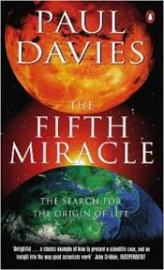
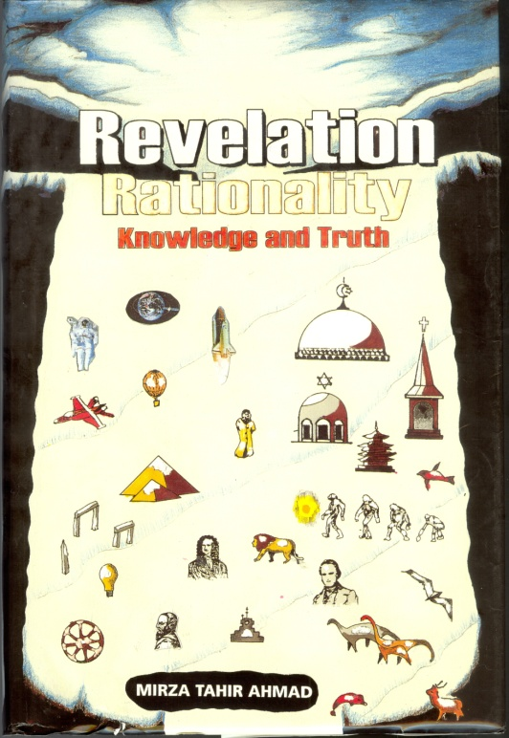
Origin and Evolution of Life
The atheists believe that life appeared as a result of random assembly of its chemical building blocks.
“Proteins contain very specific sequence of amino-acid of 20 different varieties. … Life requires hundreds of thousands of specialized proteins. ... The odds against producing just the right proteins by pure chance are something like 10⁴⁰⁰⁰⁰ to 1.” [Paul Davies, ‘The Fifth Miracle’]
The scientific establishment subscribes to the Darwinian theory of evolution and its modern synthesis, which posit that simple, primordial life evolved into all advanced forms of plant and animal life by a process of undirected random mutation and natural selection.
Many scientists – some of them atheistic – are skeptical of claims for the ability of random mutations and natural selection to account for the complexity of life.
Hazrat Mirza Ghulam Ahmad^{AS} and Hazrat Mirza Tahir Ahmad^{RZ} believed in the fact of evolution but they had deep skepticism towards the claim that undirected random process was responsible for the evolution of all living things.
“At every step of creation, choices that had to be made were made not by the blind hand of natural selection but by the will of God.” [Hazrat Mirza Tahir Ahmad^{RZ}, ‘RRKT’]
Notes:
Many scientists have declared that.
More than the numbers of atoms in the universe.

Slide 23

Miracle of Creation
He has created seven heavens in harmony. No incongruity can you see in the creation of the Gracious God. Then look again: Do you see any flaw? Look again, and yet again, your sight will return to you overwhelmed and exhausted. [67:4-5]
“If we could magnify a cell thousand million times and were to enter the cell, we would find ourselves in a world of supreme technology and bewildering complexity. It is the sheer universality of perfection, the fact that wherever we look, to whatever depth we look, we see an elegance and ingenuity of an absolutely transcending quality, which completely goes against the idea of chance.”
Michael Denton, ‘Evolution: A Theory in Crisis’
Notes:
Transmission electron microscope provides 10 million X magnification.

Slide 24
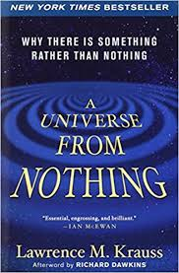
Much Ado About Nothing?
  Many atheistic physicists think that the universe came out of nothing without requiring any external agent.
  Lawrence Krauss: “I then describe how it is possible that space and time themselves could have arisen from no space and time. … One can nevertheless question whether that is nothing, because the transition is mediated by some physical laws. … One of the modern answers is that even the law themselves may be random, coming into existence along with the universe that may arise.” [‘A Universe from Nothing’]
There is no theoretical or experimental support for Krauss’s assertions.
Who wrote the majestic equations? No one can explain how the laws of physics came into existence.
How can the universe operate without a sustainer? No one can explain why the fundamental particles obey the laws of physics.
Notes:
Lawrence Krauss is a well-known theoretical physicist.
That is logical consequence of atheism.
That is a non-explanation as there ever was!

Slide 25
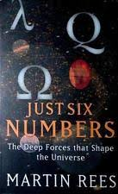
Fine-Tuning of the Universe
The universe and its physical properties are perfectly balanced and fine-tuned.
Many of the basic features of the universe are determined by the values of its six fundamental constants, as described by Martin Rees, astrophysicist and Astronomer Royale.
According Stephen Hawking, if one second after the Big Bang the rate of expansion – determined by the cosmological constant (λ = 2.90x10^{–122}) – was smaller by even 10^{–17}, the universe would have re-collapsed. If the rate of expansion was slightly higher, the galaxies would not be able to form and there would be no earth.
Nuclear efficiency (ε = 0.007) determines the strength of the binding force between neutrons and protons. If its value was 0.006, only hydrogen would be able to form – no helium, no nuclear fuel, no stars, no life. If it was 0.008, then all hydrogen would be quickly used up after the Big Bang – no hydrogen, no water, no life.
Both Stephen Hawking and Martin Rees were atheists.
Notes:
N (ratio of the electromagnetic force to gravitational force = 10³⁶)
ε (measure of how strongly atomic nuclei bind together = 0.007)
Ω (the ratio of density of the universe to the critical density = 1 at 1s after the Big Bang)
λ (lambda, cosmological constant = 2.90x10⁻¹²²)
Q (degree of structures in the universe = 10⁻⁵)
D (the number of spatial dimensions = 3)
Martin Rees called these constants “providential”!

Slide 26
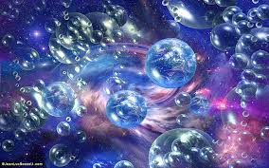
Anthropic Principle and Multiverse
The anthropic principle states that the universe must be conducive to conscious life.
In this principle, the theist sees a purposeful design by a highly intelligent creator, who created the universe so that conscious life could eventually emerge and glorify its creator.
The atheist counters that we should not be mystified by an elegant universe, because only in a universe capable of supporting intelligent life will there be living beings capable of observing it and pondering over it!
But the odds of such a universe appearing by chance is incredibly small.
This led many atheistic thinkers to speculate about infinitely many universes, called multiverse. This allows the uniqueness and fine-tuning to be dismissed by claiming that this happened in one among countless universes.
There is absolutely no theoretical or empirical evidence for this fantasy of multiverse.
Notes:
If probability of an event is extremely small, the increase the number of trials.

Slide 27
A “Proof” for the Non-Existence of God – An Imaginary Dialogue
  A. Hey theist, I can prove that God does not exist.
  T. Go ahead, my dear atheist; show me the proof.
  A. You believe God exists and you describe Him in superlative terms. You say He is the most marvelous, most powerful, most wise, etc., because He created this grand and elegant universe out of nothing. Correct?
  T. Absolutely!
  A. But I can imagine a being more formidable and greater than than your God.
  T. That is utterly impossible.
  A. It is possible. That being is more formidable and greater than your God, because it created this grand, elegant, and self-sustaining universe out of nothing without even existing. Your God is not needed – not even as an idea. Therefore, God does not exist! Q.E.D.
Notes:
This argument is from Australian philosopher Douglas Gasking.

Slide 28
Quranic Evidence
28

Slide 29
The Origin of the Universe
Do the unbelievers not see that the heavens and the earth were a closed-up mass, then we clove them asunder? And We made every living thing from water. Will then they not believe? [21:31]
And the heavens We built with our own powers and indeed We go on expanding it. [51:48]
These verses describe the origin of life, the origin of the universe as a Big Bang and its expansion.

Slide 30
Scientific Facts in the Quran
The Quran makes profound and accurate statements about scientific facts discovered only in the last two centuries.
Planetary motions along independent orbits
Different types of light emanating from the sun and the moon
Origin of the universe as envisioned in the Big Bang
Expansion of the universe
  Creation of living things from water
  Embryonic development
  Sexual reproduction
  Evolution of man in planned and progressive stages

Slide 31
Knowledge of the Future in the Quran
The Quran declared that the body of the Pharaoh, who was drowned at the Red sea, would be preserved.
  His mummified body can be seen in a museum in Cairo, Egypt.
The Quran foretold that Jewish people would be gathered in the Holy land after their dispersion.
  This came true in the creation of the state of Israel in 1948.
It predicts bringing together of wild animals.
  We see that in modern-day zoological gardens.
It prophesies merging of two seas and removing of barriers.
  Construction of Suez and Panama canals in the 19th and 20th centuries.
  It predicted pervasive use of books and printed material.
    These are everywhere today.

Slide 32
Premise and Inference
The Quran was revealed in the 7th century.
At the time, the human knowledge of science was quite rudimentary.
The Quranic text has suffered no change in the ensuing 15 centuries.
Many predications made in the Quran have come true.
The Quran contains facts about biology and cosmology, which were discovered in the modern times.
These scientific theories cannot change.
  These Quranic verses are not being misinterpreted.
  Inference: The Quran has divine origin and thus God exists.
Notes:
Are these verses being mistranslated, misinterpreted, and misconstrued?
The two underlined bullets present the points of contention.

Slide 33
Reasons for Atheism
33

Slide 34
Atheism and Agnosticism
Western Europe is becoming increasingly atheistic.
  In the U.K., 97% of the scientists who are Fellows of Royal Society do not believe in a personal God (agnostics or deists).
The scientific establishment, most intellectuals, and many common people in the U.S. are avowedly atheistic.
  In the U.S., 93% of the scientists who are members of the National Academy of Sciences do not believe in a personal God.
Atheists and agnostics lie in our discomfort zone.
Notes:
It is easier to show interpolations in the Bible and the
flaws in the belief in the divinity of Jesus than to
prove the existence of God.

Slide 35
Reasons for Atheism
Atheists do not reject the existence of God because of some scientific evidence.
The primary reason for rejecting God and religion is religion itself.
  Free will under divine omniscience
  Creation of evil by a God of virtue
  Belief in the eternal damnation
  Human suffering under a Merciful and All-powerful God
  Folk tales, anachronistic laws, irrationality, intolerance, misogynism
The dogma and doctrines of the scriptures imply a God whose grandeur does not match up with the grandeur of the universe.
Notes:
Science engenders an attitude of skepticism and a demand for evidence

Slide 36
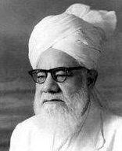
Religion, Myth, Smoke and Mirror
“Christians, Muslims and people of all other faiths have heard from their priests, their imams, and their pundits that in the beginning there was only smoke and water, from which God created all the different kinds of things; that He created the earth and the heavens in 6 days comprising 24 hours each; that He made a figure out of clay and breathed into it to create Adam, from whose rib he created Eve about 7000 years ago. … People heard all these myths until it reached their ears that science had given lie to all such tales. …
“When the credibility of a religion is attacked, and one is unable to rise to the challenge, one is likely to be suspicious about the existence of God. … Such is the case of the modern man.”
Mirza Bashir Ahmad, ‘Our God’
Notes:
Hazrat Mirza Bashir Ahmad was the second son of the Promised Messiah and
the younger brother of the second Khalifa.

Slide 37
Epilogue
37

Slide 38
Pascal’s Wager
Blaise Pascal, a 17th century philosopher, mathematician, and physicist, argued that a rational person should live as though God exists and should seek to believe in God.
  Because if God does not exist, then he will suffer finite loss (i.e., renunciation of minor pleasures), whereas if God exists, then he stands to receive infinite gains (i.e., eternity in heaven) and will avoid infinite losses (i.e., eternity in Hell).
Imam Jafar al-Sadiq in the 8th century and Imam al-Harmayn al-Juwayni in the 11th century presented a variation of the argument:
  If what you, the atheist, say is correct, then both you and I will be fine. But if what I say is correct, then I will prosper and you will be devastated.
These are deeply flawed arguments, because:
  A pretense of belief without real conviction cannot deceive God.
  Belief in God with a wrong religion cannot guarantee salvation.
  Mere belief in the right religion is not sufficient.
Notes:
Was Pascal an agnostic?
Imam Jafar addresses the atheist.

Slide 39
Conclusion
The burden of proof is on the claimant.
The rational approach is fundamental to determining this question.
The logical and scientific methods are indispensable in this quest.
By using these methods, we can show with a reasonable degree of positive certainty that a supreme creator of the universe – God – exists.
According to the Hazrat Mirza Ghulam Ahmad^{AS}, a personal experience of God leads a person to absolute certainty.

Slide 40
Q
A
&
Q U E S T I O N S
A N S W E R S
40

