Slide 1
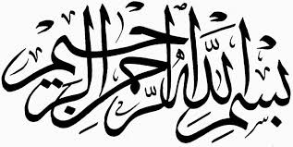
Perspectives on Jihad
Rafi Ahmed
June 30, 2019

Slide 2
Outline
Background
Scriptural basis
Abrogation
Muslim theologians
Ahmadiyya view
The West and jihad
Synopsis
2

Slide 3
Background
3

Slide 4
Prologue
Jihad is a Quranic concept.
The Arabic word, jihad, means ‘striving’.
It has come to denote any campaign made for principle or faith.
Expansionistic and imperialistic wars waged by Muslims have also been called jihad.
It is not a mandatory pillar of Islam.
Notes:
Jihad is a controversial subject with far-reaching
moral and political ramifications.
It is often mis-translated as “holy war”.

Slide 5
Spectrum of Jihad Objectives
Improving oneself morally and spiritually
Uplifting the downtrodden
Repelling aggression purely in self-defense
Fighting to end persecution and oppression
Waging war to expand Muslim hegemony
Waging war to eliminate disbelief (kufr)
Notes:
This is an extremely wide spectrum.
The last two bullets are the expansionist and militant
version of Islam, whose aim is the establishment
of Muslim hegemony, an all-powerful Muslim state,
imposition of the Islamic sharia, and finally
world domination.
The first four are permitted; the last two are not.

Slide 6
Jihad Terminology
The greater jihad (jihad-e-akbar): moral self-striving
The lesser jihad (jihad-e-asghar): war of self-defense
Jihad of the pen (jihad-bil-qalam): religious and intellectual discourse
Jihad in the cause of Allah (jihad-fi-sabilillah): all-inclusive and multi-faceted
Jihad of the sword (jihad-bis-saif): militant jihad – waging war for establishing Muslim rule
Abode of peace (dar al-salam) and abode of war (dar al-harab) – the world divided into two exclusive domains perpetually at war with each other
Notes:
These are some of the categories of jihad that are generally
used by classical and modern Muslims scholars.
Some Muslim jurists divide the world in two domains.
These are NOT Quranic concepts or phrases.

Slide 7
Scriptural Basis
7

Slide 8
Quranic Verses on Jihad
God has exalted in rank those who strive with their wealth and their persons above those who stay at home. [4:96]
And as for those who strive to meet Us, We will surely guide them in Our ways. And verily God is with those who do good. [29:70]
Notes:
The Quran has many references to jihad, but they are not
necessarily about war or fighting. It is translated as strive
or striving and underlined here.
As these verses refers to striving with financial and personal
sacrifice and moral and spiritual quest.
Jihad is different from the Arabic word qital, which means
fighting.
Ironically, the entire theological debate about jihad is based
on verses that do not refer to the term jihad.

Slide 9
Quranic Conditions for Starting War
Permission to fight is given to those against whom war is made because they have been wronged and God indeed has power to help them. [22:40]
And fight in the way of God against those who fight against you, but do not transgress. Surely, God loves not the transgressors. [2:191]
Notes:
The verses [22:40] and [2: 191-195] outline preconditions
for a starting war.
There are many similar verses in the Quran.

Slide 10
Quranic Conditions for Terminating War
… So if they keep away from you and do not fight you, and make you an offer of peace, then God has allowed you no way of aggression against them. [4:91]
Fight them until there is no persecution and religion is wholly for God. [8:40]
Notes:
The verses [8:40] and [4:91-92] refers to conditions for ending
or terminating war.
There are many similar verses in the Quran.
Therefore, these verses and the ones shown before provide the
Quranic rules of engagement.

Slide 11
Consequences of De-contextualization
When the forbidden months have passed, kill the idolaters wherever you find them, seize them, and beleaguer them and lie in wait for them at every place of ambush,
… but if they repent and observe prayers and pay the zakat then leave their way free. Surely, God is most forgiving and merciful. [9-5]
And if any of the idolaters seeks protection from you, grant him protection so that he may hear the word of God, then deliver him to his place of security. That is because they are a people who have no knowledge. [9:6]
Notes:
The verse 9:5 is perhaps the most misquoted and misinterpreted
verse in the entire Quran. This verse is often quoted in fragment,
which is underlined here.
It is presented as an unqualified commandment for an outright
massacre of the idolaters.
Pat Robertson on CNN in February 2002 quoted and showed only
the fragment of verse 9:5 from a Quran. (John King)
The next verse 9:6 guarantees protection of disbelievers, while
The verse 9:4 reminds Muslims about honoring treaties made
with non-Muslims.
These stern verses were revealed during a time of perpetual
conflicts and warfare, where Muslims faced an existential threat.
These verses must be understood in the light of the rules of
engagement presented earlier.

Slide 12
Missing Precondition?
Fight those who do not believe in God nor in the Last Day, nor consider unlawful what God and His messenger have declared to be unlawful, nor follow the true religion, until they pay tribute (jiziya) willingly as subjects. [9:29]
Notes:
The fundamentalist misinterpret this verse as a call for establishing
Muslim hegemony over non-believers.
The contextualization of this verse is difficult, since this verse
appears without any surrounding verses that could provide any
context. But 9:13 asks Muslims to fight those who broke their
pledge and attacked Muslims first.
It must be understood in conjunction with other verses delineating
the Quranic rules of engagement.

Slide 13
Jihad and Muslim Theologians
13

Slide 14
The Theory of Abrogation
The origin of doctrinal abrogation can be traced to Al-Shafii (767-820) and his book Risala.
In this view, many earlier verses of the Quran are supposed to have been repealed and supplanted by later verses.
The abrogated verses are not considered operational or obligatory.
The primary purpose of abrogation is to repeal verses that delegitimize unconditional warfare.
Notes:
Here is the fundamentalist’s dilemma: Given the explicit Quranic
rules of engagement, how can militancy be supported? The key
is abrogation. Abrogation, however, remains a contentious issue.
Shafi, the founder of one of the four major schools of jurisprudence, is
a towering figure. The theory of abrogation was proposed 150 years
after the demise of the Prophet.
Based on the idea of progressive revelation, it seeks to destroy rather
than build on previous Quranic revelations.
With focus on 9.29 and part of 9:5, earlier verses that delineate a
restrictive rules of engagement are repealed and set aside.
Has 2:107 itself been abrogated?

Slide 15
Abrogation Debate
Methods of Quranic interpretation: conflictive-selective vs. collective-synthetic
The classical and fundamentalist views endorse and advocate abrogation of Quranic verses.
Munir Inquiry Commission Report: “The generally accepted Muslim view is that the verse 9:5 abrogated the earlier verses (e.g., 22:40 and 2:191), which permitted the killings of disbelievers only in self defense.” [Pakistan, 1954]
The modernist and reformist view disavows the abrogation of Quranic verses.
Notes:
Conflictive-selective chooses some verses over others that
might appear conflicting.
Collective-synthetic method reconciles and synthesize diverse verses;
it conceptually demanding analysis, but it guarantees the finality and
integrity of the Quranic text.
The theory of abrogation goes against the sanctity, integrity, and
finality of the Quranic message. Numerous interpretations by
various jurists with their own list of abrogated verses create an
intellectual and theological anarchy.
It also gives inordinate power to the jurists and theologians.
The Commission produced a report after interviewing Muslim
jurists of the entire spectrum of points of view.

Slide 16
Scholars on Jihad
Classical
  Al-Shafii (767-820), Ahmed Ibn Hanbal (785-855), Al-Ghazali (1058–1111), Ibn Rushd (1126-1198), Ibn Taymiyyah (1263-1328)
Fundamentalist
  Muhammad bin Abdul Wahab (1703-1792), Hasan Al-Banna (1906-1949), Abul Aala Maududi (1903-1979), Sayyid Qutb (1906-1966)
Modernist
  Sir Syed Ahmad Khan (1817-1898), Muhammad Abduh (1844-1905), Rashid Rida (1865-1935), Mahmud Shaltut (1897-1963), M. Hashim Kamali (1945-)
Reformist
  Hadrat Mirza Ghulam Ahmad (1835-1908) and Hadrat Khalifatul-Masih I, II, III, IV, V
Notes:
There are essentially four categories of scholars.
As shown the classical scholars belongs to the medieval period,
while the other espoused their views in the 20th century.
The modernist and reformist views diverge significantly from the
other two.
Later, we will talk about some of these scholars in more detail.

Slide 17
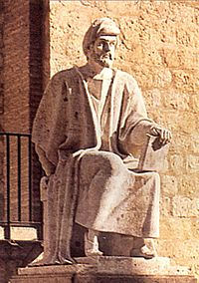
Ibn Rushd (Averroes) 1126-1198 C.E.
Ibn Rushd was a polymath born in Cordoba, Spain, during Moorish reign. He belonged to the Maliki school.
He was an eminent logician and physicist and a scholar of philosophy, jurisprudence, and theology.
His best-known work in this field is ‘The Beginning for the Independent and the End for the Follower’.
Notes:
In the west, Ibn Rushd’s name has been Latinized into Averroes.
(Maliki, Shafii, Hanbali, and Hanafi)

Slide 18
Ibn Rushd on Jihad
In his book, ‘The Beginning …’, he discusses the disagreement among scholars about the question of how conflicting Quranic verses about jihad and warfare can be resolved.
“Scholars agree that polytheists should be fought. The aim of warfare is either conversion to Islam or payment of poll-tax (jizya).”
“The conclusion of truce is considered to be permitted from the outset and without an immediate occasion. As a condition of truce, it may be stipulated that the enemy pay a certain amount of money. This is not poll-tax, because for that it would be required that they come under Islamic rule.”
Notes:
Second bullet => UNCONDITIONAL
Note that paying of the poll-tax implies that the disbelievers
come under Muslim rule.
He also opens the possibility of peace treaty, as a third option,
where neither conversion nor subjection takes place.
Ibn Rushd (12th century) sends a mixed message.

Slide 19
Ibn Taymiyyah [1263-1328 CE]
Ibn Taymiyyah, a member of the Hanbali school, was an Islamic scholar, jurist, and theologian.
He was born Turkey and lived during the time of the Mongol invasion.
He is considered one of the main founders of fundamentalism. He influenced the Salafi and Wahabi movements.
He discussed jihad and warfare in his book, ‘Governance According to God’s law in Reforming the Ruler and the Ruled’.
Notes:
He had considerable influence on the fundamentalist movements
such as Wahabi and Salafi, two of the most orthodox.

Slide 20
Ibn Taymiyyah on Jihad
Ibn Taymiyyah emphasized the many commandments to engage in jihad and warfare in his book ‘Governance According to God’s law in Reforming the Ruler and the Ruled’.
“The sharia enjoins fighting the unbelievers.”
“The most serious type of obligatory jihad is one against the unbelievers and against those Muslims who refuse to abide by certain rules of the sharia. … This form of jihad involves defense of the religion, of things that are inviolable, and of human lives.”
“The other type of jihad that involves fighting in order to propagate Islam, to make it triumph, and to intimidate the enemy is voluntary.”
Notes:
Second bullet => unconditional.
Making Islam triumph is another way of expressing the desire
for Muslim hegemony.
Notice that in Ibn Taymiyyah’s world, aggression has turned
inwards and upon itself, as Muslims have become targets of
jihad.
Nevertheless this view somewhat less invidious, since he
considers this type of jihad voluntary or optional.

Slide 21
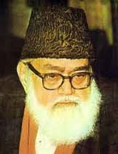
Abul Aala Maududi (1903-1979)
Abul Aala Maududi was a prominent Pakistani journalist, theologian, and a major 20th century fundamentalist thinker.
He was the founder of Jamaat-e-Islami of Pakistan, an Islamic revivalist and political party with a global reach.
He expounded his views in his book, ‘Jihad in Islam’.
Notes:
Now let us move on to the 20th century fundamentalist scholars.
Maududi, a prolific writer based in Pakistan, had considerable
influence in many Arab countries.

Slide 22
Maududi on Militant Jihad
“Islam wishes to destroy all states and governments on the face of the earth, which are opposed to the ideology and program of Islam. The purpose of Islam is to set up a state on the basis of its own ideology and program ... Towards this end, Islam wishes to press into service all forces which can bring about a revolution. And a composite term for the use of all these forces is jihad.”
“The objective of the Islamic jihad is to eliminate the rule of an un-Islamic system and establish in its stead an Islamic system of state rule. … Therefore, the Muslim group will not be content with the establishment of an Islamic state in one area alone. If the Islamic state has the power and resources, it will fight and destroy non-Islamic governments and establish Islamic states in their place.” [Jihad in Islam]
Notes:
This is the expansionist, militant version of Islam, in stark terms.
Maududi is quite unabashed about his objectives.
Notice the irrationality and impracticality of this goal.
According to him, perhaps Pakistan should declare a jihad
against the godless Chinese.

Slide 23

Hasan Al-Banna (1906-1949)
Hasan al-Banna was an Egyptian, political activist, social organizer, and theologian.
He is best known as the founder of the Muslim Brotherhood, one of the most prominent 20th century Muslim revivalist party.
He influenced fundamentalist Islamic thought of the 20th century.
Notes:
Hasan al-Banna was the founder of Muslim Brotherhood
(Ikhwanul-Muslimeen), the largest and most influential
Sunni revivalist organization in the 20th century.
It was started in Egypt in 1928. Muslim Brotherhood is
still the largest opposition party in Egypt.

Slide 24
Al-Banna on Militant Jihad
“In the Tradition, there is a clear indication of the obligation to fight the People of the Book … Jihad is not against polytheists alone, but against all who do not embrace Islam. ... It has become an individual obligation, which there is no evading, on every Muslim to engage in jihad.”
[‘On Jihad’ in Five Tracts]
Notes:
We hear the same mindless call for mobilization and militancy.

Slide 25
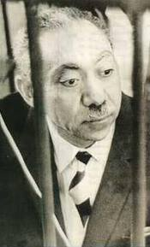
Sayyid Qutb (1906-1966)
Sayyid Qutb was an author, Islamist theorist, and a leading ideologue of the Egyptian organization Muslim Brotherhood.
He was influenced by Maududi and had great impact on modern fundamentalist thought.
He is best known for his work on the social and political role of Islam.
He authored ‘Social Justice’ and his magnum opus, ‘Blessings of the Quran’.

Slide 26
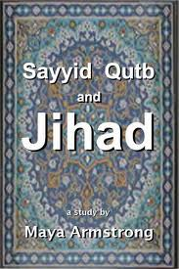
Qutb on Militant Jihad
“Islam proclaims the liberation of man on earth from the subjection to something that is not God. Therefore, Islam … has to deliver blows at the political forces … that do not rule according to the sharia and the authority of God. … However Islam does not seek to force people to embrace the creed … In the first place, it aims at putting an end to those regimes and governments that are based on the principle of subjection of men to other men.”
[Blessings of the Quran]
Notes:
The message is the same, but the language is different. This is the
only thing that distinguishes it from the classical text.
The fundamentalists have wrapped up the old ideas – old wine
in new bottle – in modern packaging by using phrases like
‘revolution’, ‘liberation of man’, and practical program borrowed
from modern political writings.
We also saw it in Maududi’s writings.

Slide 27

Wahabi View of Jihad
“You are ordered by Allah to continue in carrying out Jihad against the disbelievers till they embrace Islam and are saved from the punishment in the hell-fire or at least come under your protection.”
Translation of the Meaning of the Noble Quran [p. 687], Al Hilali,
published by the Government of Saudi Arabia, 1996.
Notes:
This is the official Saudi translation of the Quran.
And this Saudi Quran is widely available in the United States.
This provides a synopsis of the objectives of militant jihad.
This present-day view is most pernicious.

Slide 28
Modernist Thinkers
Some modern Muslim scholars take a non-militant view that jihad is permitted only as a defensive warfare.
They generally reject abrogation of Quranic verses.
These respected scholars have very little influence.
Notes:
Sir Syed was the founder of Aligarh Muslim University
in India and a preeminent leader and scholar of his time.
Muhammad Abduh became Grand Mufti of Egypt in 1889.
Rashid Rida, a Syrian journalist, was the first to
advocate a fully modernized Islamic state.
Hashim Kamali is a professor of Islamic law in Malaysia.

Slide 29

Mehmud Shaltut [1893-1963]
Prominent Egyptian scholar and theologian
He is best known for his contribution to Islamic reform.
He became Rector of Cairo’s well-known al-Azhar Islamic institute and served as grand Imam of al-Azhar mosque during Nasser years.
He authored the book, ‘Jihad and Fighting in Islam’, 1948.
Notes:
Mahmud Shaltut, a great Egyptian scholar and reformer, who was
the Rector of the Al-Azhar University in Cairo, Egypt during early
sixties.

Slide 30
Mehmud Shaltut on Fighting
“There are only three reasons for fighting, viz. to stop agression, to protect the mission of Islam, and to defend religious freedom.”
“… about 70 Quranic verses concerning fighting are considered to have been abrogated, since they are incompatible with the legitimacy of unconditional fighting.”
[Jihad and Fighting in Islam]
Notes:
He also writes that the Prophet fought only to repel agression and
oppression.

Slide 31
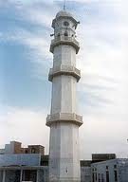
The Ahmadiyya Muslim Community and Jihad
The Ahmadiyya Muslim Community is a reformist, missionary sect, which subscribes to a tolerant, rational, and rigorous understanding of Islam.
It upholds the absolute integrity of the Quranic text, and therefore rejects the theory of abrogation.
It maintains that permission for warfare is conditional and limited in scope, and that over the ages Muslims have misconstrued this permission.
It argues that the Prophet’s jihad was a defensive war fought for the sole purpose of saving Islam and Muslims from extermination.
Notes:
Let us move on to the Reformist thinkers.
The Ahmadiyya Muslim Community has tens of millions adherent in
over180 countries. It presents a non-militant understanding of Islam.

Slide 32
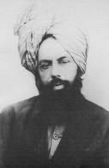
Necessary Conditions for Jihad
“There is no falsehood greater than the allegation that some critics have made that the Quran incites to jihad without any necessary conditions. The Holy Quran allows us to fight only those who prevent people from believing in God, carrying out His commandments, or worshipping Him. It commands us to fight against such people who fight against Muslims without any reason, expel believers from their lands, compel people into other faith, or attempt to exterminate the true religion.”
[Hadrat Mirza Ghulam Ahmad, Nurul-Haq, 1904]
Notes:
In 1989, Hadrat Mirza Ghulam Ahmad founded the Ahmadiyya
Muslim Community in 1889.
This is a very clear statement and leaves no doubt about the
true intent and purposes of jihad in Islam.

Slide 33
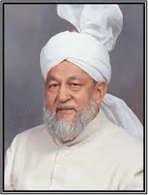
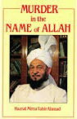
Murder in the Name of Allah
Hadrat Mirza Tahir Ahmad (1928-2003) was the fourth head (khalifa) of the Ahmadiyya Muslim Community.
His book, ‘Murder in the Name of Allah’, provides powerful refutation of the arguments for militant jihad.
It demonstrates that Islam grants full religious freedom and confutes the view that in Islam apostasy is a crime punishable by death.
Notes:
The arguments given in this book provide a powerful refutation
Of the doctrine of the militant jihad.
When a Muslim renounces Islam, he becomes an apostate.
The Ahmadi view is that no punishment for apostasy is
prescribed in Islam in this world. The others differ.

Slide 34
Jihad and the West
34

Slide 35

Conversion or Death?
“The period of Islamic conquests and empire building marks the first phase of the expansion of Islam as religion. … Jews and Christians were assigned special status as communities possessing scriptures, and therefore, were allowed religious autonomy. They were, however, required to pay a per capita tax called jiziya, as opposed to pagans, who were required to either accept Islam or die.”
[Encyclopedia Britannica, 1997, Islam]
Notes:
Notice the last sentence. Encyclopedia Britannica, the world’s
most authoritative reference book, asserts that Islam offers
only two options to pagans – they can accept Islam or be
exterminated by Muslims.
This has the echoes the misinterpreted fragment of verse 9:5.

Slide 36

Conversion or Control?
“The lesser jihad, or holy striving, means an active struggle using armed force whenever necessary. The object of such striving is not the conversion of individuals to Islam but rather gaining of political control over the collective affairs of societies to run them in accordance with the principles of Islam. … In fact, according to strict Muslim doctrine, conversion ‘by force’ is forbidden … and it is also strictly prohibited to wage wars for the sake of acquiring worldly glory, power, and rule.”
[Encyclopedia Britannica, 2006, Islam]
Encyclopedia Britannica has revised its view on jihad!
36
Notes:
The Encyclopedia Britannica changed its mind within a matter
of ten years. Now it has realized that forcible conversion is
prohibited.
It also presents a somewhat toned down version of militant
jihad, where the goal is imposing sharia and just rule.

Slide 37
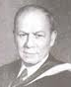
Conquest and Conversion
Unlike Judaism and Buddhism, the religion of Islam proved as much an aggressive and missionary religion as Christianity. The Islam that conquered the northern regions was not the Islamic religion but the Islamic state. … Not until the second and third centuries of the Moslem era did the bulk of the people in Syria, Mesopotamia and Persia profess the religion of Muhammad. Between the military conquest of these regions and their religious conversion a long period intervened.
[Philip K. Hitti, The Arabs: A Short History, 1949]
Notes:
Philip Hitti was a professor of Arab studies at Princeton
University.
His book “A History of Arabs” is considered a classic.
The imperialist conquest was the artifact of the Islamic state.
His observation about the time lag between conquest and
conversion settles many mis-understanding about this issue.

Slide 38
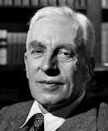
Conquest and Liberation
In the seventh century of the Christian era, the Muslim Arabs liberated … a string of Oriental countries – from Syria right across North Africa to Spain – which had been under Greek or Roman rule for nearly a thousand years. After that between the eleventh century and the sixteenth, the Muslims went on to conquer, by stages, almost the whole of India, and their religion spread peacefully still farther afield.
[Arnold Toynbee, Islam and the West, 1955]
Notes:
Arnold Toynbee is one of the most preeminent historians of the
20th century.
He believes Muslim conquest was liberation and that Islam was
spread peacefully.

Slide 39
Synopsis
39

Slide 40
Militant Jihad By Any Other Name …
… would be as abominable.
Or far worse.
Other names?
  Extermination of indigenous people, the Inquisition, the Crusades, the Holocaust, apartheid, Cultural Revolution, ethnic cleansing, imperial and neo-imperial wars …
Notes:
What is in a name? That which we call a rose
By any other name would smell as sweet.
(Romeo and Juliet)
With apologies to Shakespeare …
The list is long and excruciating.

Slide 41
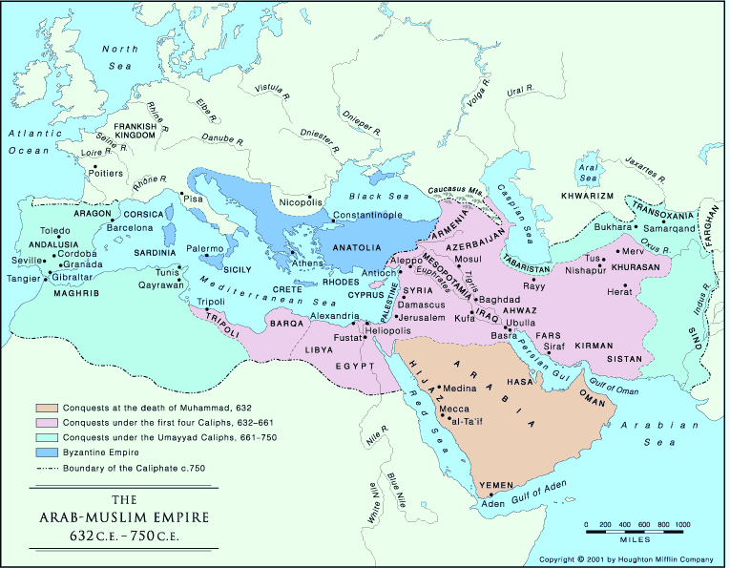
The Muslim Empire [632-750 C.E.]
Notes:
Beige is the Islamic region at the end of the Prophet’s and Hadrat Abu Bakr’s lives.
Pink is the conquest made by the rightly-guided khalifas, that is, the first four, khalifas.
The green region was added to the Muslim Empire during the time of Umayyad dynasty.
The four shifting centers of power. From Medina, to Kufah during the time of Ali, and then
Damascus, which became the capital of Muawiyah and the Umayyad dynasty; and then
Baghdad, the capital of the Abbasid dynasty.

Slide 42
Willing Accomplices of Militant Jihad
Collusion of ‘mosque’ and state
The classical jurists served the cause of imperialistic expansion and imparted religious legitimacy to military expeditions.
The fundamentalist jurists of today aim at mobilizing the masses for political gain.
Notes:
The period after the Prophet Muhammad was followed by
expansion and conquest.
In that period of, rulers sought from jurists a rationale for their
imperial goals. These jurists willingly propounded an ideology
of militant, aggressive jihad and declared that waging this jihad
was a religious duty prescribed by God.
Today many Muslim fundamentalists use the same medieval and
discredited arguments to justify their acts of terrorism and to
legitimize their use of militant methods for achieving their
political goals.

Slide 43
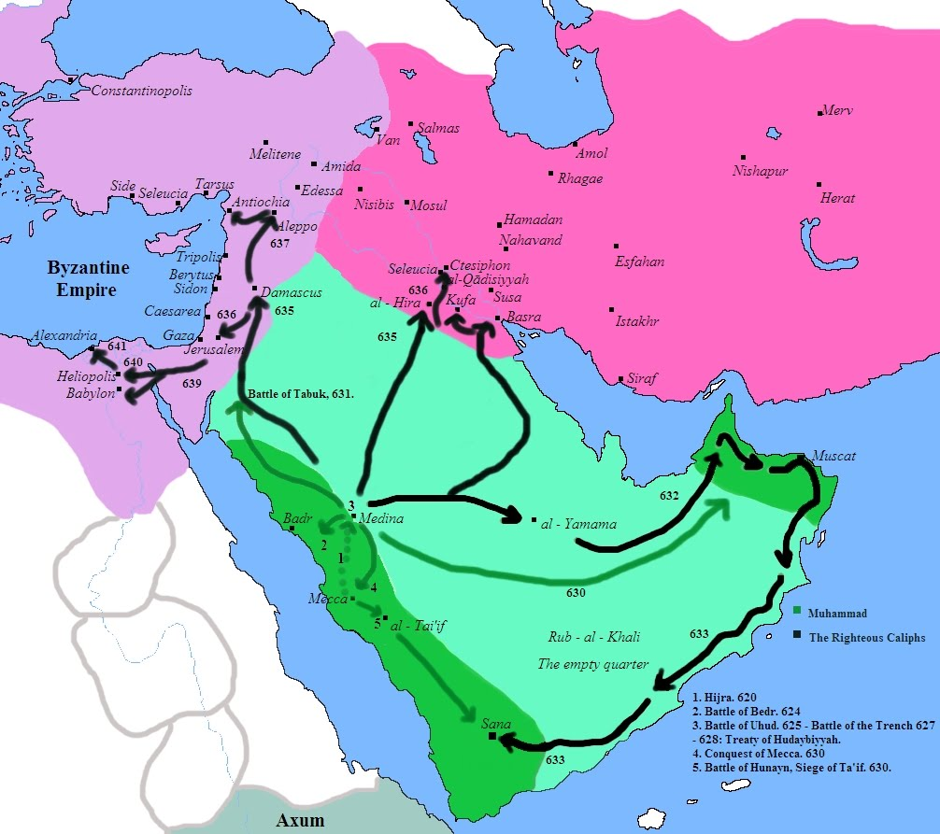
Muslim Expeditions [620-641 C.E.]
Prophet's emigration (hijrah) is shown by the red arrow.
Prophet's excursions are shown by the green arrows.
Notes:
Light pink is the Byzantine Empire. Dark pink is the Sassanid Empire.
Three types of arrows: red, green, and black
Point out the Arabian peninsula comprises light and dark
green. Hijaz is dark green area on the Western side.
At this point, the Prophet has passed away; and we are about
to embark upon a new phase in the history of Islam.

Slide 44
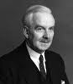
Jihad and the Prophet
“Careful reading of the Quranic passages on jihad suggests that Muhammad regarded the command to fight the unbelievers not as absolute, but as conditional upon provocation from them, for in many places this command is justified by aggression or perfidy on the part of non-Muslims. … Authoritative Muslim opinion, however, went in a different direction … Muslim scholars have argued that there is an unconditional command to fight the unbelievers. … The ‘sword verses’ are considered to have repealed all other verses concerning the intercourse with non-Muslims.”
[Jihad, Rudolph Peters, The Encyclopedia of Religion, 1987]
Notes:
Rudolph Peters is a professor of religions and history at the
University of Amsterdam. He is the author of many books
including Jihad in Classical and Modern Islam.
Here Professor Rudolf Peters demonstrates a great insight
into the Islamic history and captures the essence of the
Debate about jihad.

Slide 45
Epilogue
There is a wide spectrum of views on the objectives of jihad.
Abrogation of Quranic verses – supported by many Muslim jurists – is a theological sleight-of-hand used to justify militant jihad.
Quranic permission for war is conditional.

Slide 46
A
Q
&
Q U E S T I O N S
A N S W E R S

