Slide 1
Hazrat Al-Hajj Mirza Bashir-ud-Din Mahmood Ahmad (ra) (1889-1965) Khalifatul-Masih II (1914-1965) Second Successor to the Promised Messiah (as): His Khilafat and Magnificent Achievements

Slide 2
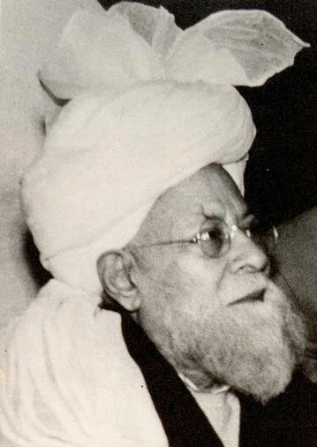

Slide 3
At the age of 19, Sahibzada Mirza Bashiruddin Mahmood Ahmad (ra) offered himself for the Waqf (dedicated his life to serve the Jama’at) and soon formed Anjuman Tashheezul Azhaan (Organization for the sharpening of intellect) and under its supervision, started a magazine of the same name, through which the work of religious education for children was carried out.
Early in 1911, with the permission of Hazrat Hakeem Nooruddin, Khalifatul-Masih I (ra), founded the Anjuman Ansarullah (Organization of Helpers of Allah) to propagate the teachings of Islam.

Slide 4
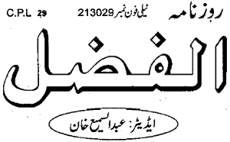
In June 1913, he started "The Al-Fazl" a newspaper for the Jama’at which, in addition to the news, published informative, educational, historical, propagational, and reformatory articles.

Slide 5
In 1914, as Khalifatul-Masih II (ra), he established Majlis-e-Shura to discuss the propagation of Islam.
To facilitate this, Huzoor (ra) created the Nazarat Dawato Tabligh (Executive Office of Preaching) in 1919, and the Madrassa (School) Ahmadiyya as the center. His untiring efforts for its advancement steered it from the status of a mere school to a University. These efforts were aimed at training learned religious missionaries.

Slide 6

The wisdom of the Holy Qur’an, provided in Huzoor’s (ra) Tafsir-e-Kabir (Greater (long) Commentary) bears undeniable evidence of his God-given knowledge of the Holy Qur’an.
The Holy Qur’an was translated into various languages so that the glory and wisdom of the Divine Book could be made available to people who did not read/understand Arabic.

Slide 7
In order to consolidate and organize the Jama’at Huzoor (ra) established the Central and Regional Anjuman (Organizations) as well as various important Nazarat (Executive Offices) under the Sadr Anjuman Ahmadiyya Qadian to facilitate all efforts:
Nazarat Dawato Tabligh (Executive Office of Propagation)
Nazarat Taleem (Executive Office of Education)
Nazarat Umoor-e-Aamma (Executive Office of General Affairs)
Nazarat Bait-ul-Mal (Executive Office of Finance) and
Nazarat Aa’la (Executive Office of Guardians) this office oversees all other executive offices

Slide 8
Huzoor (ra) formed auxiliary organizations in the Jama’at to serve the needs of both genders according to different age groups:
In 1922: Majlis Lajna Ima’Illah for women.
In 1928: Majlis Nasirat-ul-Ahmadiyya for girls ages 7-15
In 1938: Majlis Khuddam-ul-Ahmadiyya for men ages 15-40.
In 1938: Majlis Atfal-ul-Ahmadiyya for boys ages 7- 15.
In 1940: Majlis Ansarullah for men age 40 and above.

Slide 9
Hazrat Musleh Mau’ud (ra) planned, re-organized, and consolidated the financial structure of the Jama’at. He put forth various initiatives and appeals for donations and contributions. Some of these are:
An appeal for financial donations for Anjuman Taraqqi-e-Islam (Organization for the promotion of Islam) in order to send his missionaries to all the cities and towns of India for the preaching of Islam.
The initiative for the completion of Minaratul Masih.
Call to women to collect funds for preaching
Call to donate for the London Mosque.

Slide 10
Through the important initiative of Tahrik-e-Jadid in 1934, many Ahmadiyya Muslim Missions were established the world over.
Similarly, the initiative of Waqf-e-Jadid came about in order to promote missionary and reformative activities of the Jama’at in every city, town, and village in India and Pakistan by appointing teachers everywhere for rural communities. This initiative was introduced on September 27, 1957.

Slide 11
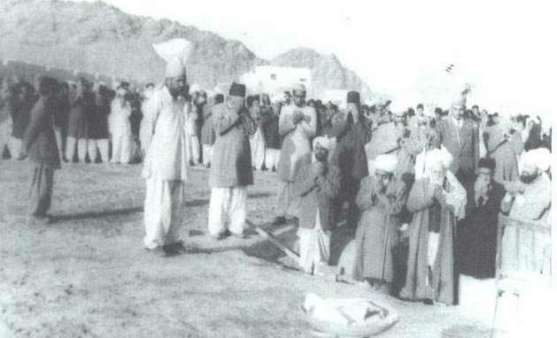
Hazrat Khalifatul-Masih II (ra) laid the foundation stone of Fazl-e-Umar hospital in Rabwah, Pakistan, in 1958

Slide 12
This is only a very brief glimpse of some of the magnificent achievements of Hazrat Musleh Mau’ud (ra).
All members are encouraged to read and research more about his life and service to Islam Ahmadiyyat.
May Allah help us all to aspire to and to implement the expectations of this great leader, Amin.

